Slide 1
Chapter 8 Supervised Learning

Slide 2
Machine Learning
Machine Learning gives computers the ability to learn (from data) without being explicitly programmed.
Machine learning can be applied in a range of tasks where designing and programming explicit algorithms with good performance is difficult.

Slide 3
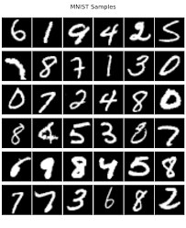
MNIST Database

Slide 4
Machine Learning Problems
Supervised Learning
Example inputs and outputs are given.
The goal is to learn a rule that maps inputs to outputs.
Unsupervised Learning
No labels are given.
The goal is to discover hidden patterns in data.
Reinforcement Learning
A computer program interacts with a dynamic environment in order to achieve a certain goal.

Slide 5
Some Other Terms
Artificial intelligence is the study of intelligent agents – any device that perceives its environment and take actions that maximize its chance of success at some goal.
Data mining is the practice of extracting knowledge, patterns and regularities from data.
Data science is an interdisciplinary field about scientific methods, processes and systems to extract knowledge or insights from data.

Slide 6
Machine Learning Process
Data sampling
Data preparation
Data partitioning
Data exploration
Model construction
Model assessment

Slide 7
Supervised Learning
Supervised Learning: data mining methods for predicting an outcome (the dependent variable) on a set of independent variables, or features.
Supervised learning can be used for
Regression – predicting a continuous outcome
Classification – predicting a categorical outcome

Slide 8
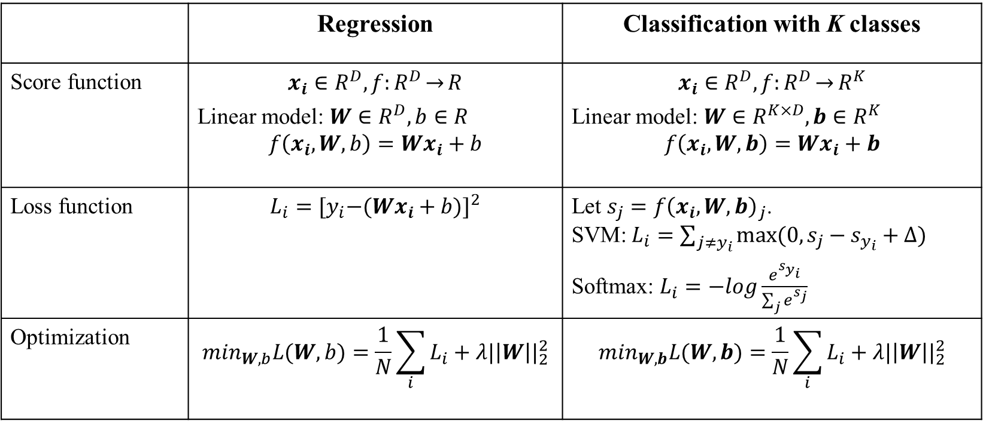
Formalizing the Supervised Learning Problem
 | Regression | Classification with K classes
Score function | $$x_{i}∈R^{D}, f:R^{D}\overset{→}{}R$$ Linear model: $W∈R^{D},b∈R$ $$f\left(x_{i}, W,b\right)=Wx_{i}+b$$ | $$x_{i}∈R^{D}, f:R^{D}\overset{→}{}R^{K}$$ Linear model: $W∈R^{K×D},b∈R^{K}$ $$f\left(x_{i}, W,b\right)=Wx_{i}+b$$
Loss function | $$L_{i}={{[y}_{i}−(Wx_{i}+b)]}^{2}$$ | Let $s_{j}={f\left(x_{i}, W,b\right)}_{j}$. SVM: $L_{i}=\sum_{j≠y_{i}}{max⁡(0, s_{j}−s_{y_{i}}+∆)}$ Softmax: $L_{i}=−log\frac{e^{s_{y_{i}}^{}}}{\sum_{j}{e^{s_{j}}}}$
Optimization | $$\min_{W,b}L(W,b)=\frac{1}{N}\sum_{i}{L_{i}}+λ{|\left|W\right||}_{2}^{2}$$ | $$\min_{W,b}L(W,b)=\frac{1}{N}\sum_{i}{L_{i}}+λ{|\left|W\right||}_{2}^{2}$$

Slide 9
Data Preparation
Data are said to be “dirty” or “raw” before being preprocessed.
Data preparation makes heavy use of descriptive statistics and data visualization methods.
Common tasks include treating missing data, identifying erroneous data and outliers, and defining appropriate ways to represent variables.

Slide 10
Options to Treat Missing Data
Discard observations with any missing data
Discard variables with any missing data
Fill in missing entries with estimated values
Apply a data mining algorithm (such as classification and regression trees) to handle missing values

Slide 11
Outliers and Erroneous Data
Tools: summary statistics, histograms, PivotTables, scatter plots, etc.
Outliers may suggest an error or a need for further investigation.

Slide 12
Variable Representation
Dimension reduction is the process of removing variables from the analysis without losing any crucial information.
Examine pairwise correlations to select variables to aggregate or remove
Representing qualitative variables
0-1 dummy variables
Combine categories to reduce the number of dummy variables

Slide 13
Variable Selection
Special procedures are sometimes employed to select the independent variables to include in the regression model
Backward elimination
Forward selection
Stepwise selection
Best subsets
The first three are iterative procedures. At each step, a single independent variable is added or removed and the new model is evaluated.
The best subsets procedure evaluates regression models involving different subsets of the independent variables.

Slide 14
Overfitting
Results from creating an overly complex model to explain idiosyncrasies in the sample data
Results from the use of complex functional forms or independent variables that do not have meaningful relationships with the dependent variable
If a model is overfit to the sample data, it will perform better on the sample data used to fit the model than it will on other data from the population
Thus, an overfit model can be misleading about its predictive capability and its interpretation

Slide 15
Avoid Overfitting
Use only independent variables that you expect to have real and meaningful relationships with the dependent variable
Use complex models, such as quadratic models and piecewise linear regression models, only when you have a reasonable expectation that such complexity provides a more accurate depiction of what you are modeling
Do not let software dictate your model; use iterative modeling procedures, such as the stepwise and best-subsets procedures, only for guidance and not to generate your final model

Slide 16
Holdout Method
The sample data are randomly divided into mutually exclusive and collectively exhaustive training and validation sets
Training set: The data set used to build the candidate models that appear to make practical sense
Validation set: The set of data used to compare model performances and ultimately pick a model for predicting values of the dependent variable

Slide 17
Cross Validation
k-fold cross-validation: The sample data are randomly divided into k equal-sized, mutually exclusive, and collectively exhaustive subsets called fold, and k iterations are executed.
Leave-one-out cross-validation: For a sample of n observations, an iteration consists of estimating the model on n – 1 observations and evaluating the model on the single observation that was omitted from the training data

Slide 18
Data Partitioning
Model overfitting occurs when the analyst builds a model that does a great job of explaining the sample of data on which it is based, but fails to accurately predict outside the sample data
We can use the abundance of data to guard against the potential for overfitting by decomposing the data set into three partitions:
The training set
The validation set
The test set
print('accuracy: %5.3f" %accuracy_score(y_test, y_pred))
print('accuracy: %5.3f" %accuracy_score(y_test, y_pred))
print('accuracy: %5.3f" %accuracy_score(y_test, y_pred))

Slide 19
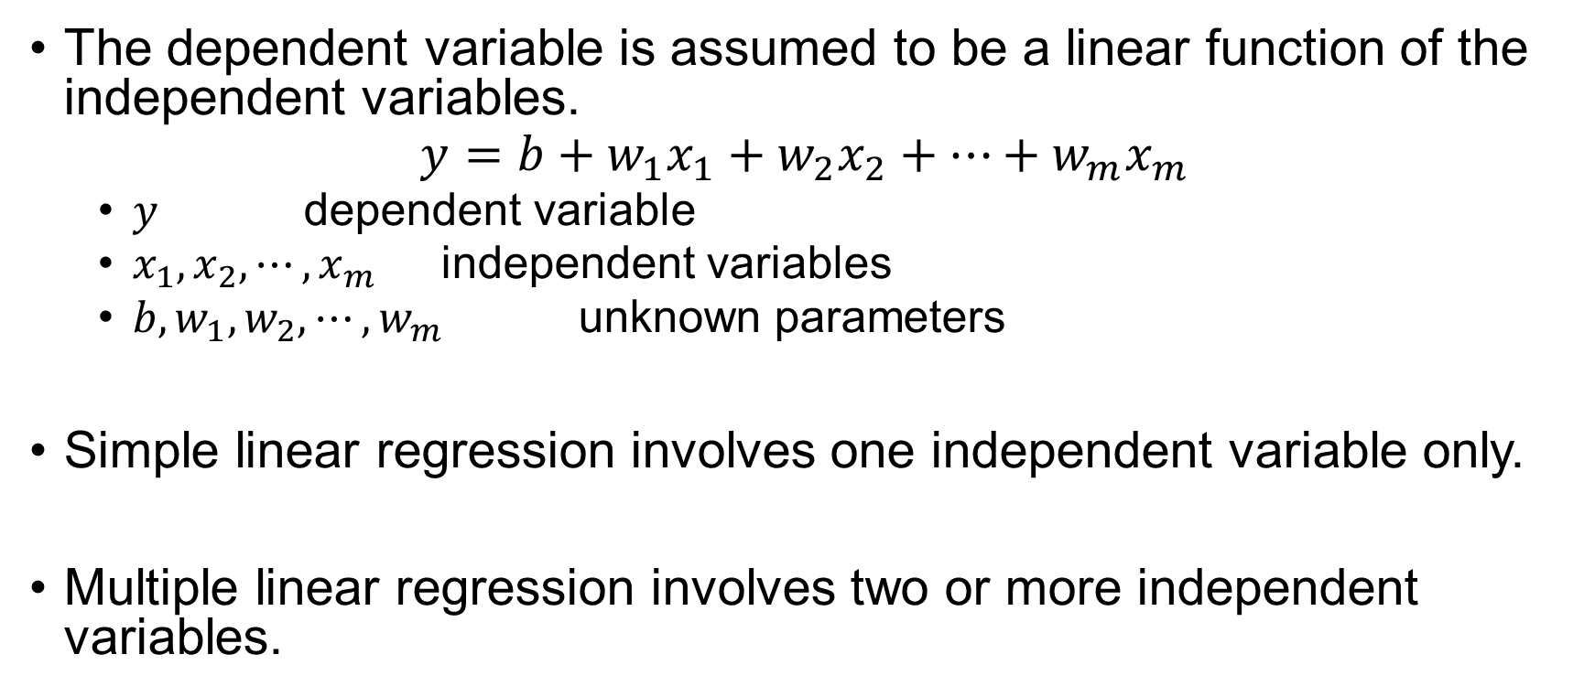
Linear Regression
The dependent variable is assumed to be a linear function of the independent variables.
$$y=b+w_{1}x_{1}+w_{2}x_{2}+⋯+w_{m}x_{m}$$
$y$ dependent variable
$x_{1}, x_{2}, ⋯, x_{m}$ independent variables
$b, w_{1}, w_{2},⋯,w_{m}$ unknown parameters
Simple linear regression involves one independent variable only.
Multiple linear regression involves two or more independent variables.

Slide 20
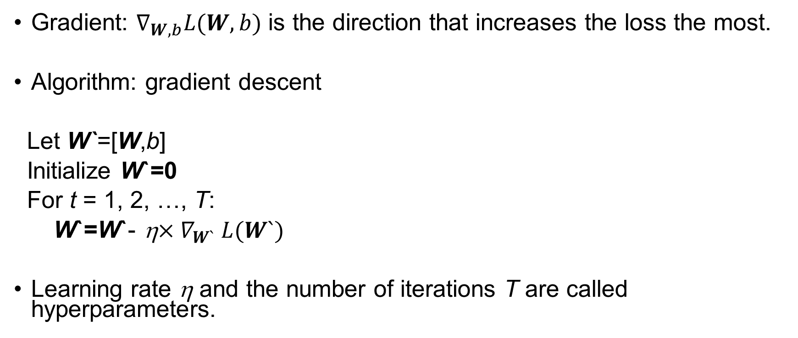
Gradient Descent
Gradient: $∇_{W,b}L(W,b)$ is the direction that increases the loss the most.
Algorithm: gradient descent
Let W`=[W,b]
Initialize W`=0
For t = 1, 2, …, T:
W`=W`- η${×∇}_{W`}L(W`)$
Learning rate η and the number of iterations T are called hyperparameters.

Slide 21
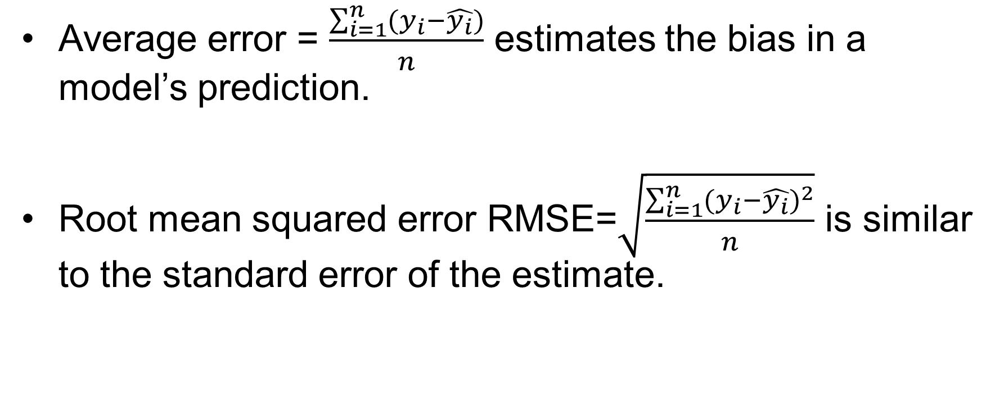
Measures - Regression
Average error = $\frac{\sum_{i=1}^{n}{(y_{i}−\hat{y_{i}})}}{n}$ estimates the bias in a model’s prediction.
Root mean squared error RMSE=$\sqrt{\frac{\sum_{i=1}^{n}{{(y_{i}−\hat{y_{i}})}^{2}}}{n}}$ is similar to the standard error of the estimate.

Slide 22
Applications of Classification
Fraud detection
Churn prediction
Default prediction
Target advertising
Spam email filtering
Tumor diagnosis

Slide 23
Classification Algorithms
Logistic Regression
k-Nearest Neighbors
Classification Tree

Slide 24
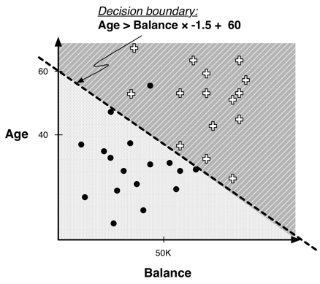
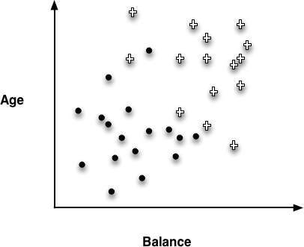
Linear Classifier

Slide 25
Classification Confusion Matrix
Confusion Matrix
A confusion matrix is a cross-tabulation of the actual class and the predicted class of all observations.
Two types of errors: false positive and false negative
 |  | Predicted Class
 |  | Yes | No
Actual Class | Positive | True Positive (TP) | False Negative (FN)
 | Negative | False Positive (FP) | True Negative (TN)

Slide 26
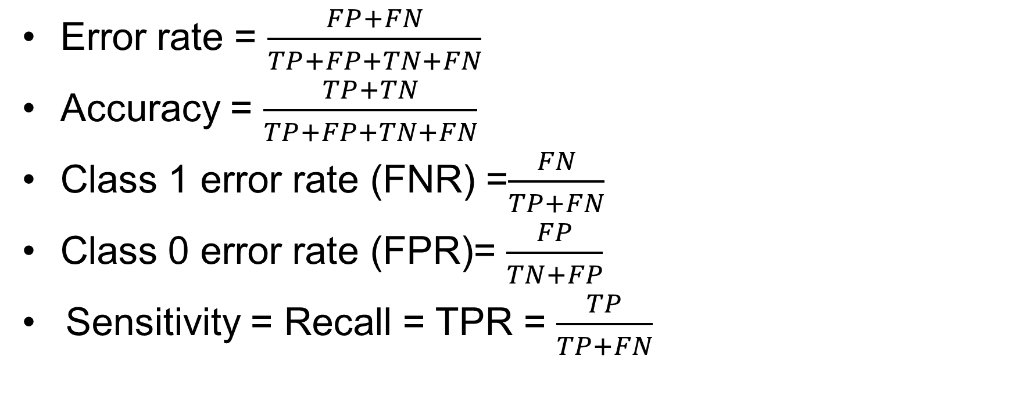
Measures - Classification
Error rate = $\frac{FP+FN}{TP+FP+TN+FN}$
Accuracy = $\frac{TP+TN}{TP+FP+TN+FN}$
Class 1 error rate (FNR) =$\frac{FN}{TP+FN}$
Class 0 error rate (FPR)= $\frac{FP}{TN+FP}$
Sensitivity = Recall = TPR = $\frac{TP}{TP+FN}$

Slide 27
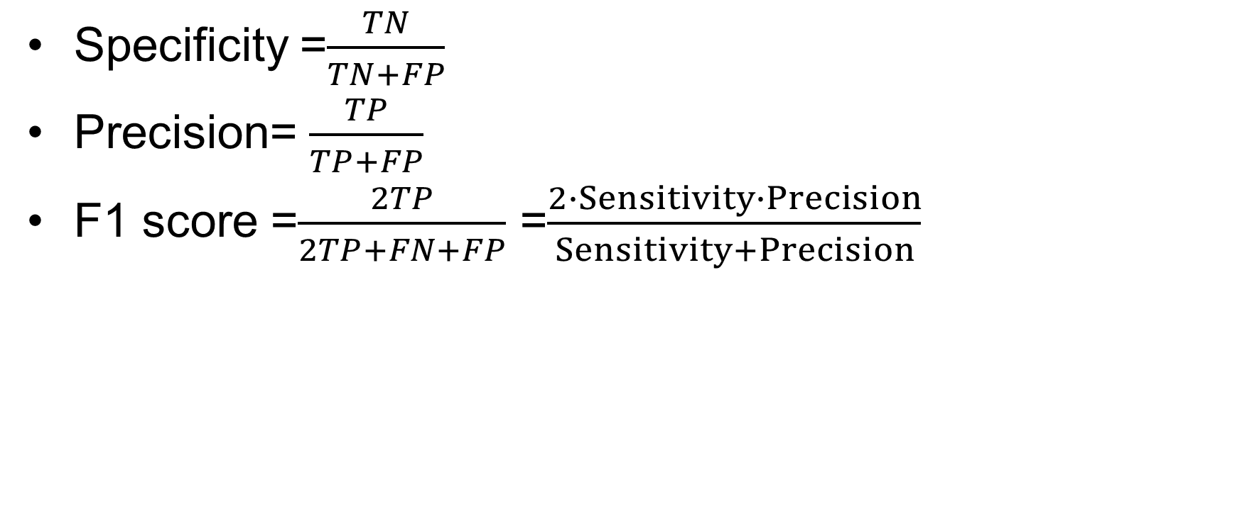
Measures – Classification (Cont’d)
Specificity =$\frac{TN}{TN+FP}$
Precision= $\frac{TP}{TP+FP}$
F1 score =$\frac{2TP}{2TP+FN+FP}$ =$\frac{2∙Sensitivity∙Precision}{Sensitivity+Precision}$

Slide 28
Receiver Operating Characteristic (ROC) Curve
Horizontal axis – false positive rate (FPR)
Vertical axis – true positive rate (TPR)
Every point on the ROC curve represents a confusion matrix.
The diagonal line represents random performance.

Slide 29
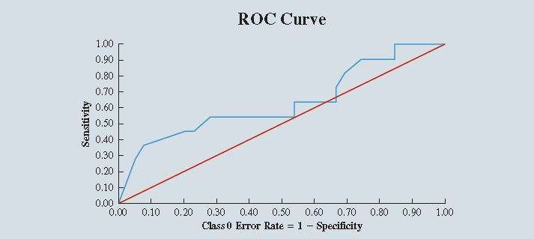
ROC Curve (Cont’d)

Slide 30
The Area Under the Curve (AUC)
AUC is the area under a classifier’s ROC curve expressed as a fraction of the unit square.
AUC is between 0 and 1.
The more area under the ROC curve, the better the classifier performs.
AUC of a random classifier is 0.5.

Slide 31
k-Nearest Neighbors
We want to predict a new record’s target value. k-Nearest Neighbors (k-NN) uses the k most similar observations from the training set.
Similarity is typically measured with Euclidean distance.
The value of k can plausibly range from 1 to n, the number of observations in the training set

Slide 32
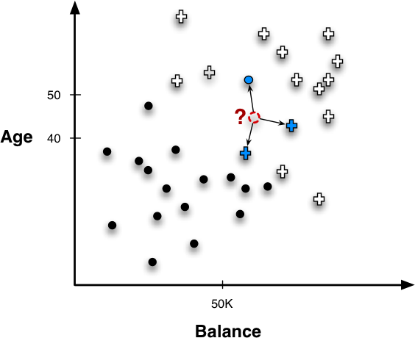
k-Nearest Neighbors for Predictive Modeling
Classification Use a new record’s k-nearest neighbors to estimate the class probabilities for this new record.
Regression A new record’s target value is predicted to be the average of the outcome values of its k nearest neighbors in the training set.

